Slide 1





ANALYSIS FOR IPL 2024
Power bi Dashboard

Slide 2
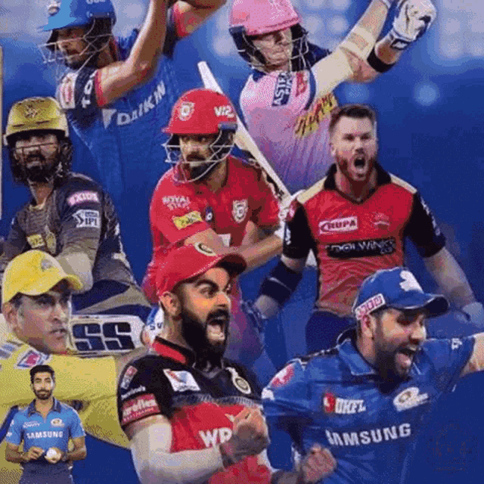
Content
01
ProblemStatement
02
Data Modeling
03
Batsman Analysis
04
Bowlers Analysis
05
Team Analysis
06
Best Players
07
Final 11

Slide 3


PROBLEM STATEMENT
"Sports Basics" is a sports blog company that entered space recently. They wanted to get more traffic to their website by releasing a special edition magazine on IPL 2024.This magazine aims to provide interesting insights and facts for fans, analysts and teams based on the last 3 years' data.

Slide 4


Microsoft Power BI

Slide 5
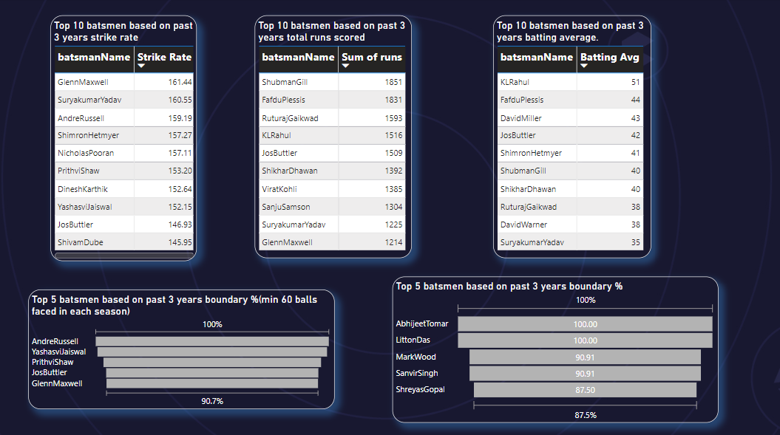

Slide 6
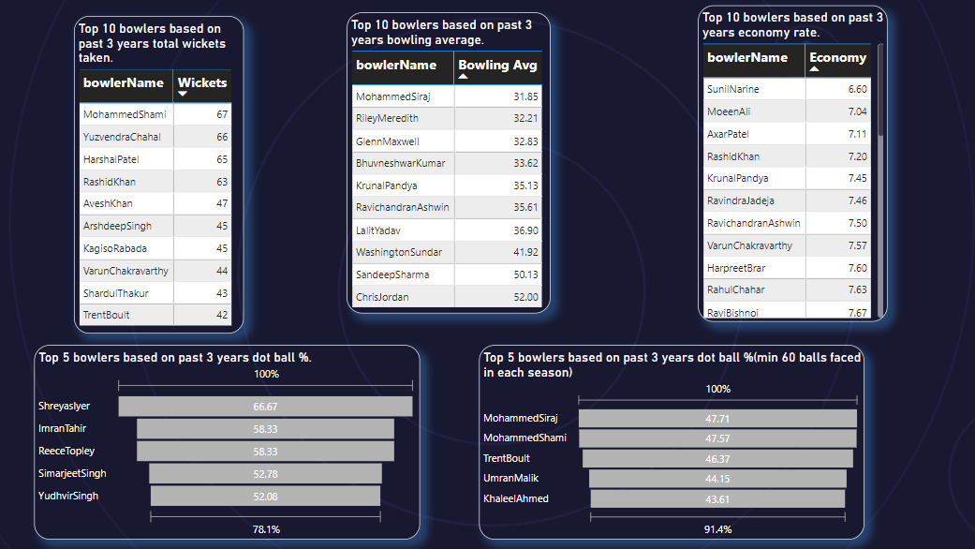

Slide 7




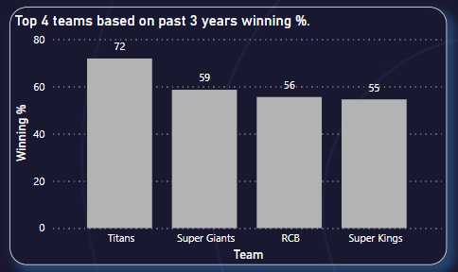

TOP 4 TEAMS
based on past 3 years winning %.
01
Titans
Super Giants
02
03
RCB
Super Kings
04

Slide 8


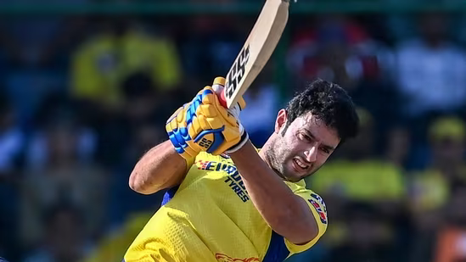
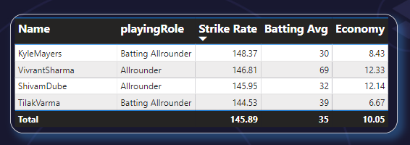
Top 3 All Rounders
Tilak Varma
Kyle Mayers
Shivam Dube

Slide 9
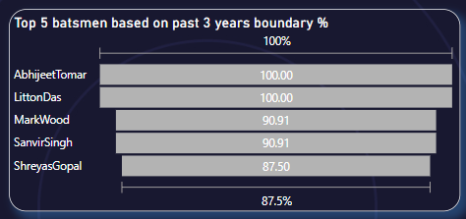



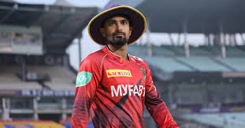

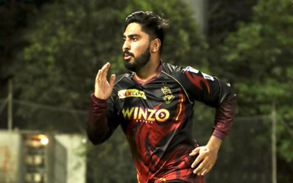
Shreyas Gopal
SAnvir Singh
Top 5 Batsman
based on past 3 years boundary %
Mark Wood
Litton Das
Abhijeet Tomar

Slide 10
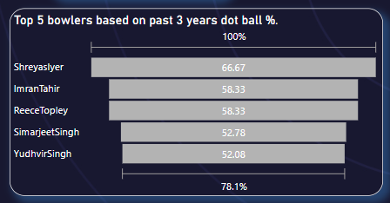

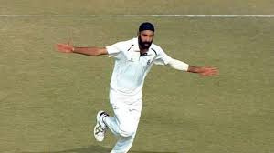

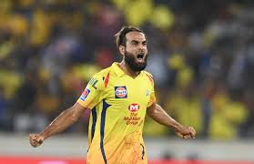
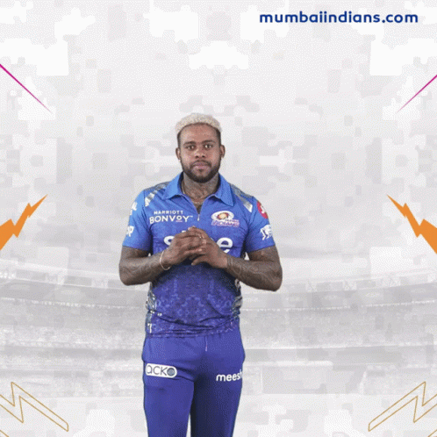

Yudhvir Singh
Simarjeet Singh
Top 5 Bowlers
Race Topley
based on past 3 years dot ball %.
Imran Tahir
Shreyas Iyer

Slide 11






THANK YOU
Remy Marsh
7249823619
karnikravina10@gmail.com
https://ravinakarnik.github.io/portfolio.io/

Slide 12

THANKS FOR WATCHING
YOUR FEEDBACK IS HIGHLY APPRECIATED PLEASE SHARE YOUR THOUGHTS IN COMMENT SECTION BELOW

